Slide 1
RC_week3
Yixuan Wang
2018/9/26

Slide 2
Content
Sequence
Limit
Mathematical Induction
Exercise

Slide 3
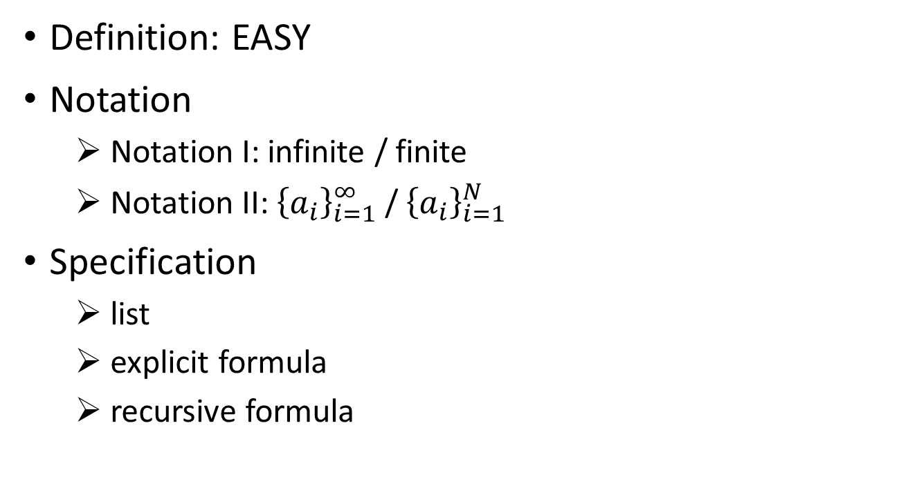
Sequence
Definition: EASY
Notation
Notation I: infinite / finite
Notation II: ${\left\{a_{i}\right\}}_{i=1}^{∞}$ / ${\left\{a_{i}\right\}}_{i=1}^{N}$
Specification
list
explicit formula
recursive formula

Slide 4
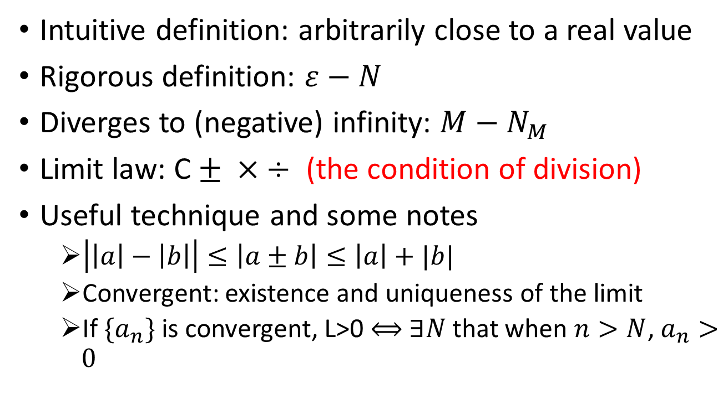
Limit
Intuitive definition: arbitrarily close to a real value
Rigorous definition: $ε−N$
Diverges to (negative) infinity: $M−N_{M}$
Limit law: C $± × ÷$ (the condition of division)
Useful technique and some notes
$\left|\left|a\right|−\left|b\right|\right|≤\left|a±b\right|≤\left|a\right|+|b|$
Convergent: existence and uniqueness of the limit
If $\{a_{n}\}$ is convergent, L>0 $⟺$ $∃N$ that when $n>N$, $a_{n}>0$

Slide 5
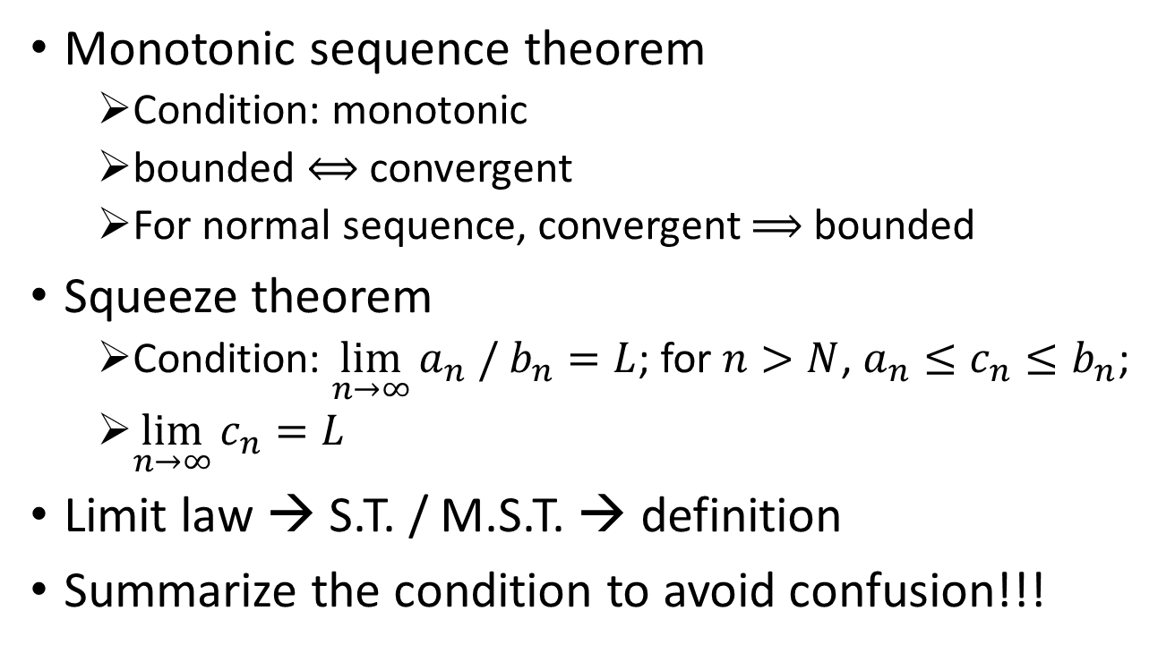
Limit
Monotonic sequence theorem
Condition: monotonic
bounded $⟺$ convergent
For normal sequence, convergent $⟹$ bounded
Squeeze theorem
Condition: $\lim_{n→∞}{a_{n} / b_{n}}=L$; for $n>N$, $a_{n}≤c_{n}≤b_{n}$;
$\lim_{n→∞}{c_{n}}=L$
Limit law → S.T. / M.S.T. → definition
Summarize the condition to avoid confusion!!!

Slide 6
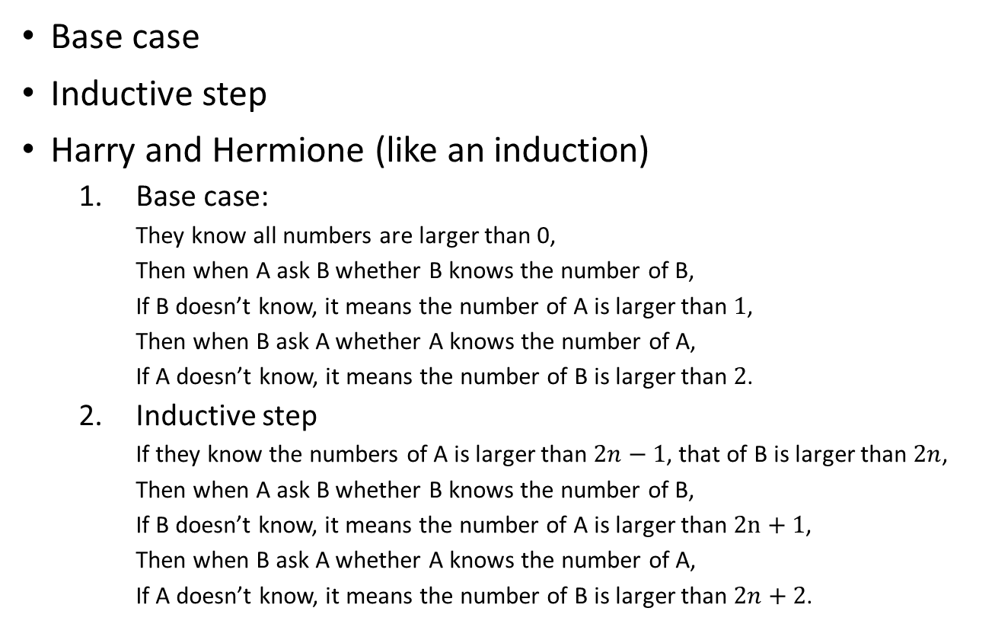
Mathematical Induction
Base case
Inductive step
Harry and Hermione (like an induction)
Base case:
They know all numbers are larger than 0,
Then when A ask B whether B knows the number of B,
If B doesn’t know, it means the number of A is larger than $1$,
Then when B ask A whether A knows the number of A,
If A doesn’t know, it means the number of B is larger than $2$.
Inductive step
If they know the numbers of A is larger than $2n−1$, that of B is larger than $2n$,
Then when A ask B whether B knows the number of B,
If B doesn’t know, it means the number of A is larger than $2n+1$,
Then when B ask A whether A knows the number of A,
If A doesn’t know, it means the number of B is larger than $2n+2$.

Slide 7
Exercise
Refer to worksheet

